Slide 1
JSON
(JavaScript Object Notation)
BEST PRACTICES

Slide 2
JavaScript Object Notation (JSON)
JSON stands for JavaScript Object Notation
JSON is easy to read and write.
JSON is a lightweight data-interchange format
JSON is plain text written in JavaScript object notation
JSON is used to send data between computers
JSON is language independent
It was designed for human-readable data interchange.
The official Internet media type for JSON is application/json.
The filename extension is .json.
JSON supports a wide range of data types that can be combined to express the structure of most data
Benefits:
Compact, efficient format, Easily readable, Broadly supported, Self-describing, Flexible format

Slide 3
Why Use JSON?
The JSON format is syntactically similar to the code for creating JavaScript objects. Because of this, a JavaScript program can easily convert JSON data into JavaScript objects.
Since the format is text only, JSON data can easily be sent between computers, and used by any programming language.
JavaScript has a built in function for converting JSON strings into JavaScript objects:
JSON.parse()
JavaScript also has a built in function for converting an object into a JSON string:
JSON.stringify()
You can receive pure text from a server and use it as a JavaScript object.
You can send a JavaScript object to a server in pure text format.
You can work with data as JavaScript objects, with no complicated parsing and translations.
It is used while writing JavaScript based applications that includes browser extensions and websites.
Web services and APIs use JSON format to provide public data.
When storing data, the data has to be a certain format, and regardless of where you choose to store it, text is always one of the legal formats. JSON makes it possible to store JavaScript objects as text.

Slide 4
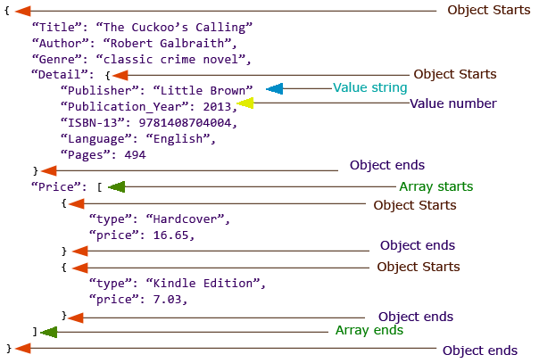
Understanding JSON Structure

Slide 5
JSON - Data Types
Type | Description
Number | Double- precision floating-point format in JavaScript {"age":30}
String | Double-quoted Unicode with backslash escaping {"name":"John"}
Boolean | True or False {"sale":true}
Array | An ordered sequence of values {"employees":["John", "Anna", "Peter"]}
Value | It can be a string, a number, true or false, null etc
Object | An unordered collection of key:value pairs {"employee":{"name":"John", "age":30, "city":"New York"}}
Whitespace | Can be used between any pair of tokens
null | Empty {"name":null}

Slide 6
Bad Special Characters & Solution
Characters | Replace with
Backspace | \b
Form feed | \f
Newline | \n
Carriage return | \r
Tab | \t
Double quote | \"
Backslash | \\

Slide 7
Enclose within DOUBLE Quotes
Always enclose the Key : Value pair within double quotes. It may be convenient (not sure how) to generate with Single quotes, but JSON parser don’t like to parse JSON objects with single quotes.
For numerical Values, quotes are optional but is a good practice to enclose them in double quote.
{'id': '1','name':File} is not right ✘
{"id": 1,"name":"File"} is okay ✓
{"id": "1","name":"File"} is the best ✓

Slide 8
No Hyphens Please
Never Never Never use Hyphens in your Key fields. It breaks python, scala parser and developers have to escape it to use those fields.
Instead of Hyphens use underscores (_). But using alllower case or camel Case is the best. See samples below.
{"first-name":"Rachel","last-name":"Green"} is not right. ✘
{"first_name":"Rachel","last_name":"Green"} is okay ✓
{"firstname":"Rachel","lastname":"Green"} is okay ✓
{"firstName":"Rachel","lastName":"Green"} is the best. ✓

Slide 9
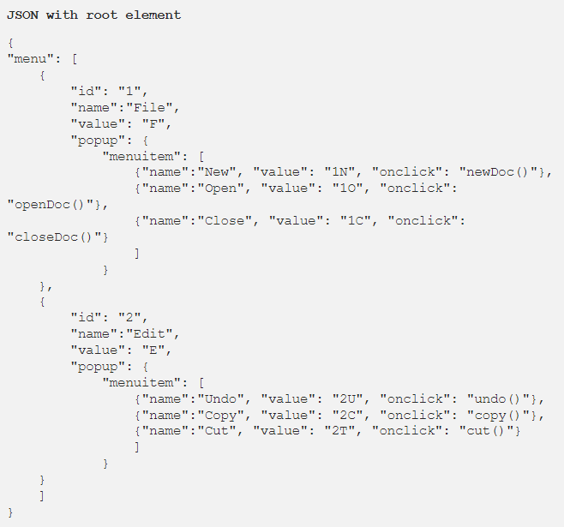
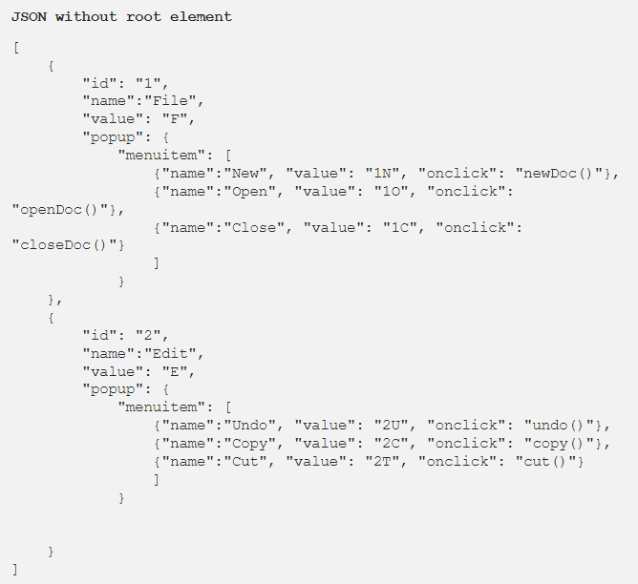
Always Create a Root Element.
Creation of Root element is optional, but it helps when you are generating complicated JSON.

Slide 10
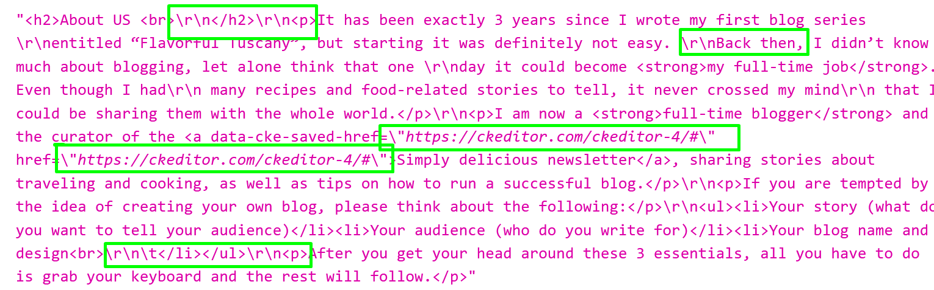
Bad Special Characters And Solution

Slide 11
Validating JSON Output
Using command line tools like ajv-cli / jsonlint (can be installed via any package manager) will eliminate trouble for consumers.

